Slide 1









My Number Interactive Notebook
$$×$$
$$\frac{1}{2}$$
$$÷$$
$$+$$
$$−$$
$$\frac{3}{5}$$
$$7$$
Name
Class
Teacher
Term 1 Semester 1
$$5^{2}$$
$$\sqrt{9}$$
1

Slide 2
Create your own front page
It needs to contain the following –
My number interactive notebook
Name
Class
Teachers Name
Semester 1 Term 1
Page number 1

Slide 3
Contents
Glossary or Formula Page
Page
Date
Description
2
3

Slide 4
Tasks
24
7
30
Essential Question
Questions
Notes
Summary
4
5

Slide 5
24
7
30
Date
Addition and Subtraction Strategies
EQ – What strategies we can use to add and subtract mentally?

Slide 6
24
7
30
Date
Addition and Subtraction Strategies
EQ – What strategies we can use to add and subtract mentally?
Numbers can be added in any order and the answer will always be the same. This is called the Commutative Law.
This law does not hold for subtraction, and you shouldn’t forget about BIMDAS.

Slide 7
24
7
30
Date
Addition and Subtraction Strategies
EQ – What strategies we can use to add and subtract mentally?
Numbers can be added in any order and the answer will always be the same. This is called the Commutative Law.
This law does not hold for subtraction, and you shouldn’t forget about BIMDAS.
What is the commutative law?

Slide 8
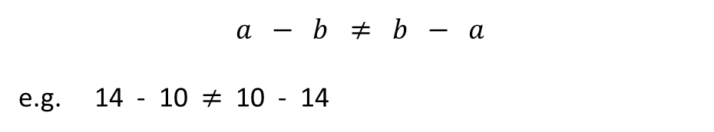
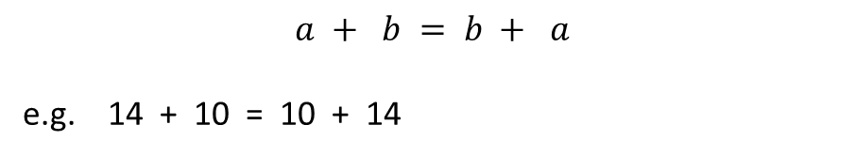
24
7
30
Date
Addition and Subtraction Strategies
EQ – What strategies we can use to add and subtract mentally?
Numbers can be added in any order and the answer will always be the same. This is called the Commutative Law.
This law does not hold for subtraction, and you shouldn’t forget about BIMDAS.
What is the commutative law?
$$a + b = b + a$$
e.g. 14 + 10 = 10 + 14
$$a − b ≠ b − a$$
e.g. 14 - 10 $≠$ 10 - 14

Slide 9
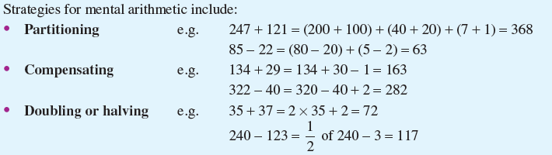
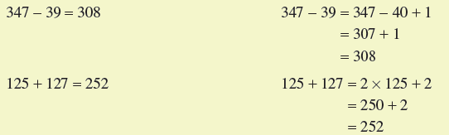
24
7
30
Date
Addition and Subtraction Strategies
EQ – What strategies we can use to add and subtract mentally?
Partitioning
Compensating
Doubling or halving

Slide 10
24
7
30
Date
Addition and Subtraction Strategies
EQ – What strategies we can use to add and subtract mentally?
Discussion:
Can you think of and describe any more strategies that you use?

Slide 11
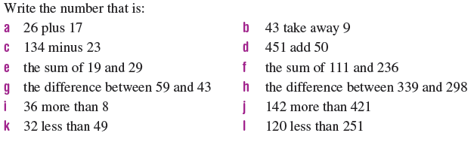
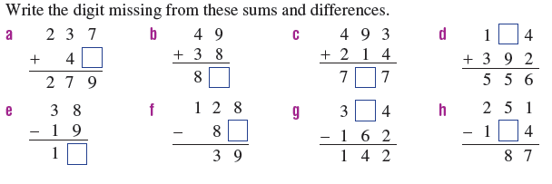
Task

Slide 12
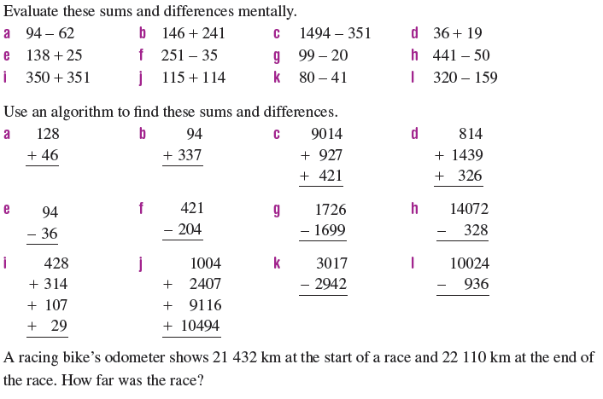
Task

Slide 13
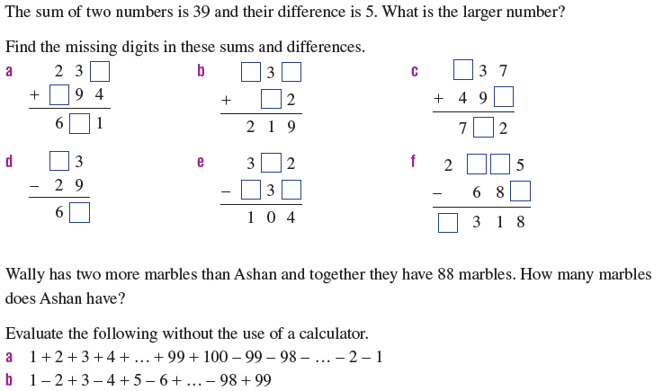
Task

Slide 14
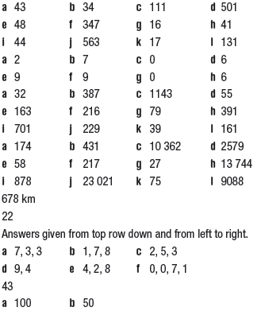
Answers

Slide 15
Notes Review
24, 7 ,30
Date
Title
Essential question
Notes complete
Notes complete with colour and diagrams
Questions completed
Contents page filled in
Formula page filled in

Slide 16
Homework
Review your notes and write a summary answering the essential question.

